Slide 1


Slide 2
md.Shofiqul islam
Asst.professor, english dept.
Halta dawatala wazed ali khan degree college
Bamna, barguna.

Slide 3
Class : eleven
Subject : English
Topic : environment pollution
Time: 50 minutes
Date: 07.05.2013

Slide 4
Objectives /learning outcome
[ A seen comprehension will be given here ]
To know the meaning of some new
words and their alternatives;
To learn different types of pollution ;
To learn how to prevent pollution ;

Slide 5
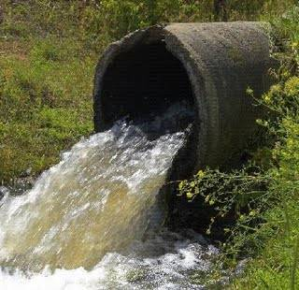
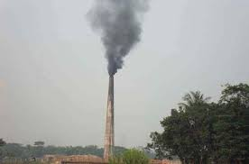
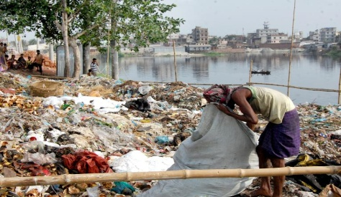
Individual work:
New Words:
Toxic (adj.) - Poisonous
Belch (V)- Emit
Filth (n) – waste materials

Slide 6
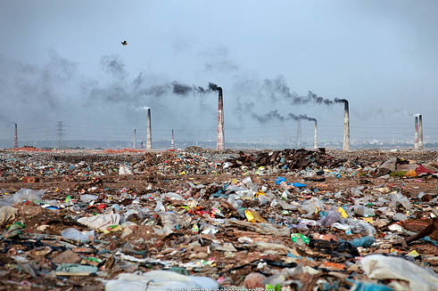
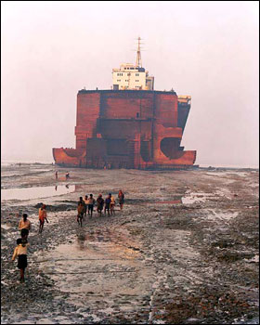
Emitting smoke
Oil seeping from damaged Ship/ Supertanker
Group work: What is happening here? What may be the effect or result of it?

Slide 7
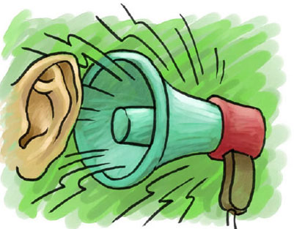
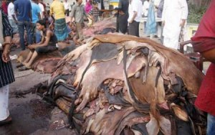
Microphone
Tannery
Group work: What sort of pollutions are causing
here ?

Slide 8
Evaluation
1.What is Environment. .
2. Mention the causes of pollution.
3.What sort of diseases may be caused due to pollution?

Slide 9
Home Work
Make a list of five points about the way of
keeping Environment free from Pollution:

Slide 10


